Slide 1
Purpose of Software
Why do we write software?
to solve problems
to ease complexity
to automate tasks
to work efficiently
Is writing software easy?
Software is complex!!!

Slide 2
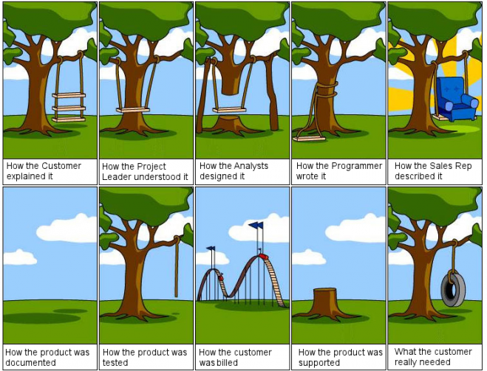

Slide 3
Why Software Is Complex?
Grady Booch mentions following elements that are responsible for the complexity of the software
Unavoidable domain complexity
Impedance mismatch between users & developers
users may find it difficult to express their requirements
Changing nature of requirements
Difficulty in managing the developmental process
big teams
Flexibility possible through software
Problems of characterizing the behavior of discrete systems
Notes:
The four elements of complexity of software domain are
Complexity of the problem domain – Through software we try to solve a number of problems, which have unavoidable complexities. Think of a simulation application that simulates the working of an aircraft. The raw functionality of such systems is quite difficult to comprehend and also adds up the non functional requirements such as usability, performance, cost, reliability, etc. This unrestrained external complexity is the cause of complexity that Brooke writes about.
The common reason of the complexity is the impedance mismatch that exists between the users of a system and its developers. It is generally hard for the users to express precise requirements in the form that developers can understand. In most of the cases, users have only vague ideas of what they want from the system. Users and developers would usually lack expertise in the problem domain and might have different perspectives and assumptions on the nature of the problem.
Things are further complicated by the fact that the requirements of the software systems often change during its development. After seeing prototypes or design documents, user better understands his needs and articulates his real needs that causes the software to change. Or the requirements might change for a different reason altogether.
Since, a lot of investment in terms of time & money goes into such software, it is not possible to scrap it every time the requirements change
Difficulty of managing the development process – The fundamental task of the software development team is to give an illusion of simplicity. The users have to be shielded from the vast complexity of the software. Such software is huge in size and we try to invent ways of writing less code, such as using frameworks or reusing existing code. The whole process is managed through teams of developers, project managers & architects. It is impossible for one person to understand such system completely. But having teams poses a different set of challenges. More developers mean more complex communication and hence, difficult coordination especially if the teams are in different geographical locations.
Flexibility possible through software – In industries such as manufacturing, construction, etc, most of the components are not produced in-house. Rather, they are ordered from other companies. But in software industry, the opposite is true. Since, software gives us great flexibility, it is possible for the developer to express any kind of abstraction. This turns out to be very addictive, but it also forces the developers to create all the primitive building blocks upon which such abstractions would stand. While other industries have uniform codes and standards, very few standards exist in the software industry. This causes software development to be a human intensive effort
Problems of characterizing the behavior of software systems – It is possible to predict the behavior of certain systems. We know if the brake is applied while the car is moving, the car will come to a stop (assuming the brakes are working fine). But in software systems making such predictions are difficult. A normal sized application might have thousands of variables, multiple threads executing simultaneously, memory allocations on stack & heap, etc. This application is executed on computers which has discrete components with discrete states. Such discrete systems have a finite number of possible states and in large systems there is a combinatorial explosion that makes this number very large. So we try to design our systems with a separation of concerns, so that the behavior of one part may not effect the other. But with so many states & events, it is not always deterministic. In the worst case, an external event may bring down a whole system, simply because the developers failed to account for one particular interaction between events. With modern day systems, it becomes even more difficult

Slide 4
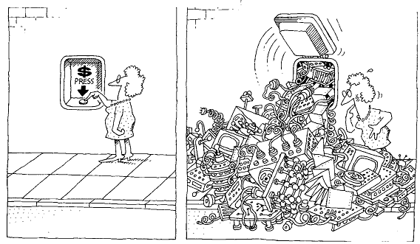
Complexity
Software developers strive to create an illusion of simplicity

Slide 5
How To Resolve Complexity
Complexity can be resolved in two ways
algorithmic decomposition
object oriented decomposition
Algorithmic decomposition is concerned with the decomposition of problem into algorithms
In object oriented decomposition, we identify players or objects that are part of the system. These objects collaborate with each other to give rise to the functionality of the system
Notes:
Complexity can be resolved through various ways. Dijkstra says, “The technique of mastering complexity has been known since ancient times: divide et impera (divide & rule). When designing any system, it is essential to decompose it into smaller & smaller parts, each of which can be refined independently. This becomes natural for humans to comprehend; only a few parts at once.
In algorithm decomposition, the problem is decomposed as a set of algorithmic steps. Each module in the system may denote a major step of some process
In object oriented decomposition, instead of decomposing the problems in steps, we identify the players (objects) in the system. In such system, the world is viewed as a set of autonomous agents that collaborate to perform some higher level behavior. Each agent (object) has its own set of properties and behaviors. Objects are directed to do things by sending them messages.

Slide 6
Resolving Complexity
Human beings have a built-in mechanism for dealing with complexity
Decompose each part into smaller parts till each part makes sense individually
Finally, integrate the parts to build the final system
“divide et impera” – divide and rule
Same principle is applied to programming languages
Notes:
deal with complexity by breaking it down

Slide 7
Algorithmic Decomposition
Decomposes the problem into algorithms
Each algorithm is part of a series of steps (part of overall process)
Typically, a top-down approach
start with a big picture
break down into smaller chunks
These steps lead to the final result (like a flow chart)

Slide 8
Algorithmic Decomposition
ALGORITHM A
ALGORITHM B
ALGORITHM C
DATA

Slide 9
Disadvantages
Development based on the high-level specification
Often changes over time
parts have to be rewritten
Algorithms are very specific to the application, thus, difficult to reuse
Difficult to add new features
algorithms are wired to work together

Slide 10
Disadvantages
Data is treated with low significance
data is shared between algorithms
unintentional modification can lead to disastrous results
Focus on operations
no idea about the entity on which operation is performed
doesn’t map to real life entities
overall understanding of the application becomes complicated

Slide 11

Object Oriented Decomposition
Humans can also abstract complexity and focus only on necessary details
unwanted details are ignored
deal with relevant details only
leads to simple entities in the problem domain
OS
Storage
Battery
Networks
Screen size
Camera
Filesystem type
Battery type
Camera aperture
Image format
Color space
USB Type
Charging
Notes:
Interview example

Slide 12
Object Oriented Decomposition
Recognize relationship between these entities
some entities may be generalized
Understand how they interact and coordinate
The coordination gives rise to the functionality of the system
Notes:
Interview example

Slide 13
Object Oriented Decomposition
Uses bottom-up design
The system is decomposed as a set of autonomous, but cooperative agents
These agents are objects and represent key abstractions in the problem domain
designed with detail
Each object has its own behaviour
May model some object in the real world
The objects coordinate with each other
coordination gives rise to functionality of the system
send messages to each other

Slide 14
Object Oriented Decomposition
Messages
Object A
Object E
Behaviour & Data
Object B
Object X
Object D
Object C

Slide 15
Advantages
Follows separation of concerns
each entity has its own responsibility
addresses the complexity through organization
System is made of objects that represent real-life entities
Maps closely to real-world problems
Data has high importance
part of the object, not visible externally
Enables generalization of objects
promotes reuse of common functionality
leads to smaller systems
Evolve incrementally over a period of time

Slide 16
Evolution
Early computer languages were created for scientific and mathematical operations
To accommodate complexity and large systems, new languages were invented
Procedural languages were used for a long time, until complexity of systems further increased
required reuse, scalability
Eventually, OO languages like Simula, Smalltalk, C++, Java, etc came into picture
The building block in these languages are classes & objects rather than algorithms

Slide 17
Object Definition
An object represents an individual, identifiable item, unit or entity, either real or abstract, with a well defined role in the problem domain *
-Smith and Tockey
Model some part of reality
Exists in space and time
Can be invented as outcome of a design process
Has well-defined behaviour and a definite purpose
Collaborate with other objects to provide a higher-level behaviour
* Smith, M., and Tockey, S. 1988. An Integrated Approach to Software Requirements Definition Using Objects:Boeing Commercial Airplane Support Division

Slide 18
Characteristics
An object has the following characteristics:
state
identity
behaviour
The structure and behaviour of similar objects are specified in a class
object is an instance of such class
a class is the blueprint for objects
Forms the building block of an application

Slide 19
State
Properties and their values constitute the state of an object
Appear as attributes of an object
fields, member variables, etc
Can be of two types
static – fundamental attributes that don’t change
dynamic – attributes that change as a result of operation performed on the object

Slide 20
Foundations Of Object Model
Programming languages evolved for developers who were trying to build system using algorithms as their building blocks
Similarly, OO design methods have evolved to help the developers to exploit the power of OO programming languages
So, object model builds upon three concepts
object-oriented analysis
object-oriented design
object-oriented programming

Slide 21
Object Oriented Analysis
Method of analysis that examines the requirements from the perspective of the classes & objects found in the vocabulary of the problem domain
This is the first step for developing an object-oriented system
Investigation of problem and requirements rather solution
Focuses on what the system is supposed to do rather how it will be done
Looks at the behaviour of the system independent of its domain
Examines the real-world environment in which the system will operate

Slide 22
Object-Oriented Design
It is a method of design that implements a system using a collection of classes & objects
OO design uses different notations to express different models of the logical & physical design of a system
OOD emphasizes proper & effective structuring of the complex system using OOP
OOD transforms the conceptual model of OOA to take into account the constraints of architecture, platform, language, etc
The result is detailed description of how the system is to be built

Slide 23
Object-Oriented Programming
It is a method of implementation in which programs are organized as cooperative collections of objects, each of which represents an instance of some class, and whose classes are all members of a hierarchy of classes united via inheritance relationships
The three important points in this definition are that OO programming
uses objects, & not algorithms as its fundamental building blocks
each object is an instance of some class
classes are related to each other via inheritance relationships

Slide 24
OO Languages
Object oriented languages evolved to help the developers to exploit the power of object oriented programming
This led to concept called as object model that contains the following important pillars
Abstraction
Encapsulation
Hierarchy
Polymorphism
Modularity

Slide 25
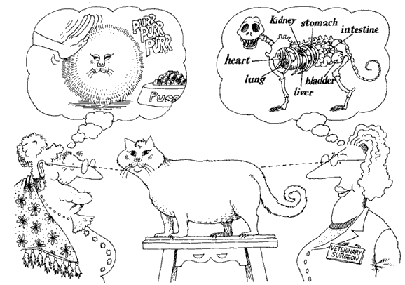
Abstraction
Abstraction focuses upon the essential characteristics of some object, relative to the perspective of the viewer
From Object-Oriented Analysis and Design with Applications
Notes:
An abstraction denotes the essential characteristics of an object that distinguish it from all other kinds of objects and thus provide crisply defined conceptual boundaries, relative to the perspective of the viewer

Slide 26
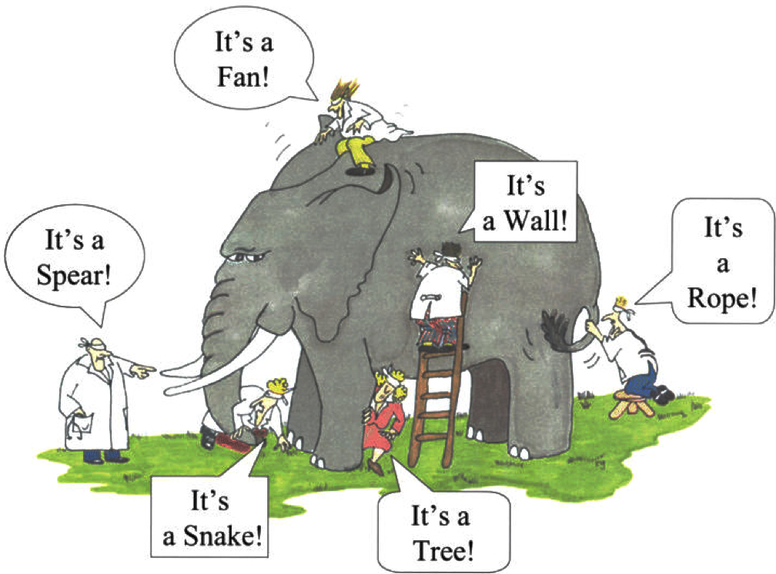
Abstraction
The abstraction is performed based on the domain
Performing correct abstraction for a given domain in necessary
Domain expertise is important for performing correct abstraction
Focus on entity abstraction
represents a useful model of domain entity
closely matches with the vocabulary of the problem domain
e.g Bank, Account, Transaction, etc
Notes:
Entity abstraction is implemented as a class/structure in OO languages

Slide 27

Abstraction Example
Requirements
Application to store & calculate academic record of the students. e.g. total/average marks, grade, etc.

Slide 28
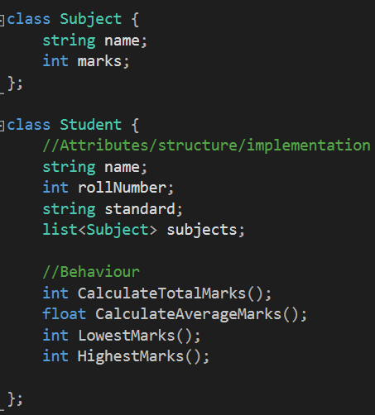
Example
Contains only those attributes and behaviours that are necessary for the school.
Height, gender, food habits, etc. are not required (even though every student has these attributes)

Slide 29
Discussion
Resolves complexity
Representation of real-life objects as software entities
Unnecessary details are left out as the focus is only on elements that are valid in the current problem domain
Easy to model a solution for a problem
A class/structure/interface is an abstraction

Slide 30
Abstraction
The elements of abstraction provide a behaviour of the object through implementation
Upholds the contract of its behaviour
This implementation should be treated as a secret
kept hidden from clients
This is achieved through encapsulation

Slide 31
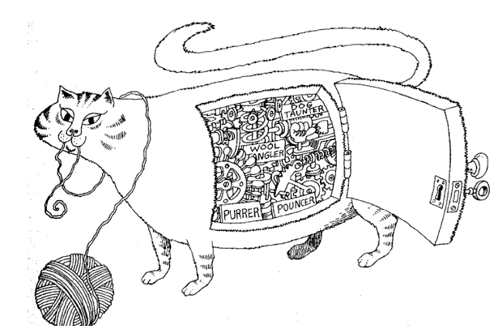
Encapsulation
Encapsulation hides the internal details of an object
From Object-Oriented Analysis and Design with Applications
Notes:
Encapsulation is the process of compartmentalizing the elements of an abstraction that constitute its structure and behavior; encapsulation serves to separate the contractual interface of an abstraction and its implementation
Abstraction & encapsulation are complementary concepts. Abstraction focuses upon behavior of an object, whereas encapsulation focuses upon the implementation that gives rise to this behavior.
Liskov says “for abstraction to work, implementations must be encapsulated”. This means that a class must have two parts: an interface and an implementation. The interface of a class captures only its outside view, encompassing our abstraction of the behavior common to all the instances of the class. The implementation of a class comprises the representation of the abstraction as well as the mechanisms that achieve the desired behavior.

Slide 32
Abstraction
The elements of abstraction provide a behaviour of the object through implementation
Upholds the contract of its behaviour
This implementation should be treated as a secret
kept hidden from clients
This is achieved through encapsulation

Slide 33
Encapsulation
Abstractions work only when encapsulated
Every class will have two parts: an interface and an implementation
Interface captures the outside view and provides the behaviour
Clients will make assumptions based on the outside view
Implementation is encapsulated, so clients cannot make any assumptions on those details
In turn, the abstraction is required to be accountable for its behaviour

Slide 34
Advantages
Clients don’t (& shouldn’t) need to see the implementation details
Change in internal implementation doesn’t effect the clients
Encapsulation decouples clients from implementation details
Enforces state changes to object only through behaviour
Helps in building scalable & flexible systems

Slide 35
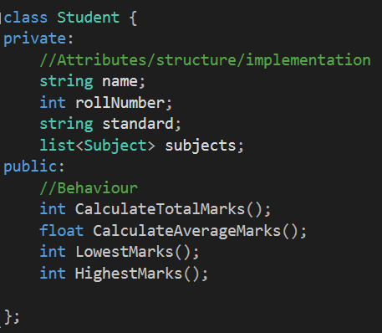
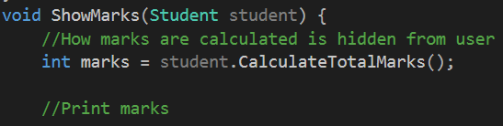
Example

Slide 36
Hierarchy
Hierarchy is a ranking or ordering of abstractions
Abstraction helps represent domain objects to resolve complexity
Encapsulation further hides the implementation details
The complexity can be reduced further by creating hierarchy of abstractions
hierarchy represents relationships between abstractions
Helps represent the problem domain and its objects
The important hierarchies in a complex system are
inheritance
containment

Slide 37
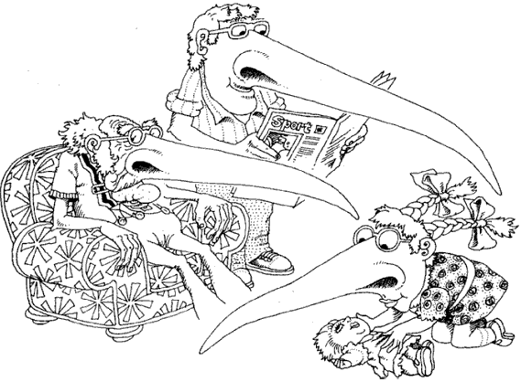
Inheritance
In “is a” relationship, a subclass will inherit the structure
& behavior of its superclass
From Object-Oriented Analysis and Design with Applications
Notes:
Consider different sorting algorithms. The behavior is same for all the algorithms, so this behavior can be standardized in a class called as SortingAlgorithm. This class can have a method called as Sort. All the other sorting algorithm classes can inherit from this class and provide a specialized behavior of sort algorithm. This asserts “is a” relationship.

Slide 38
Inheritance
Inheritance is a common technique for reusing functionality in OO systems
Often known as white-box reuse
It refers to visibility
the internal structure of the parent classes is visible to subclasses
Defined statically at compile time
The implementation of the parent class can be easily modified by overriding
Easy and straightforward to use

Slide 39
Hierarchy: "is a" Relationship
Car
ElectricCar
PetrolCar

Slide 40
Discussion
Helps in classification of objects based on their behaviour and implementation
Enables reuse of existing code, thus avoiding code duplication
Organizes the complexity and breaks it down into manageable chunks

Slide 41
Inheritance
When using inheritance incorrectly,
you can’t change the implementations inherited from the parent at run-time
a subclass is exposed to details of its parent’s implementation, so “inheritance breaks encapsulation”.
the implementation of a subclass become tightly coupled with its parent’s implementation
any change in the parent class will force the subclass to change
This creates a dependency which limits flexibility and ultimately, reusability.
Notes:
Another example can be of a Stack inheriting from an Array. You can implement push and pop by calling Array’s methods. But what would happen if the user calls clear() method of Array which is inherited into the Stack class? The Stack would be in an undefined state.

Slide 42
Abstract Class
Some methods in the base class may not have an implementation
These methods exist to provide only the behaviour that the subclasses must implement
Such methods are abstract (or pure virtual in C++) and the class also becomes an abstract class
An abstract class cannot be instantiated
It can have non-abstract methods, fields, static members, etc
The subclass will become abstract if it does not override abstract methods from base

Slide 43
Example
Frame
+Create:void
+OnCreate(void):void
+OnDestroy(void):void
+SetTitle(title:sting):void
Window
+OnCreate:void
+OnDestroy:void

Slide 44
Interface
Collection of operations that do not have any implementation
Similar to abstract class that has all methods as abstract (or pure virtual)
cannot be instantiated
all methods are implicitly public
The methods have to be implemented by the child classes
Interfaces are used as connections between applications or libraries or components

Slide 45
Interface
<<interface>>
ISerializable
+Serialize(out:ofstream):void
+Deserialize(in:ifstream):void
Employee
+Serialize(out:ofstream):void
+Deserialize(in:ifstream):void
Realization Arrow
ISerializable
Employee
+Serialize(out:ofstream):void
+Deserialize(in:ifstream):void

Slide 46
Abstract Class Vs. Interface
Abstract Class
Interface
Can contain fields or methods
May provide default implementation of some behaviour
Subclasses extend the behaviour of the base
Subclasses cannot inherit from multiple abstract classes
Can have different access modifiers
Use to represent common behaviour and implementation when different subclasses are related
Contains only behaviour
Cannot contain any implementation
Subclasses implement the behaviour of the interface
Subclasses can implement multiple interfaces
All methods are public
Use to represent common behaviour that “must” be implemented by disparate classes

Slide 47
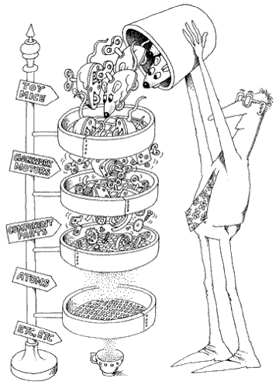
Containment
Abstractions form a hierarchy. In this example, the toy mice are composed of other objects and signifies “part of” relationship
From Object-Oriented Analysis and Design with Applications
Notes:
Example of “part of” relationship is a Window that contains a button or a classroom that contains students. Here the question of ownership is raised. In aggregation relationship, the inner object’s lifetime is not necessarily controlled by the outer object. For example, if the classroom is destroyed, the students will not be destroyed; instead they might become a part of other classroom.
Containment suggests strong relationship in which the lifetimes of the objects are intertwined together. When the outer object is destroyed, the inner object is automatically destroyed e.g. a window having a button.

Slide 48
Containment
This is a relationship between objects
Signifies “has a” relationship
One object may contain another object to reuse its behaviour
Multiple forms of containment exist
Composition
Aggregation
Association
Dependency

Slide 49
Composition
This is a strong relationship & signifies a physical containment
One object is “part of” another object
The outer object is responsible for its lifetime
E.g. Button is part of Window
When the Window is closed, the button is also destroyed

Slide 50
Example
Window
Button
AddressBook
Contact

Slide 51
Aggregation
Denotes a logical containment of an object
Weaker than composition
E.g. training has students
Training does not physically contain the students
The students are shared with other trainings
A training does not control the lifetime of its students; they exist independently

Slide 52
Example
Training
students
Training
Student
Car
Passenger

Slide 53
Association
This also implies reuse of objects
Represents a semantic connection between the classes
A class will contain a reference of another object and use it for some time
Often accompanied with phrases such as uses, controls, etc
E.g. Analyst analyses Requirements

Slide 54
Example
Analyst
analyses
Requirements
Manager
manages
Team

Slide 55
Containment
Object containment is another form of reuse
New functionality is obtained by assembling or composing objects to get more complex system
Known as “black-box reuse”, because no internal details of the objects are visible
Composition can be defined dynamically at runtime through references or pointers to other objects
Objects are accessed solely through their interfaces that reduces dependencies
Any object can be replaced at runtime by another as long as they are of the same type.

Slide 56
Containment
With containment
classes are kept encapsulated and are focused on one task unlike inheritance
class hierarchies remain small and objects are light-weight
OO systems will have more objects and the system’s behavior will depend on their interrelationships instead of being defined in one class
But containment cannot be effectively used without inheritance
Inheritance and containment thus work together in a well designed OO system

Slide 57
How to use inheritance?
Use inheritance
for representing common behavior
substitutability
overriding/polymorphism
Avoid
using inheritance for inheriting implementation
inheriting from concrete classes
Ensure the hierarchy satisfies “is a” rule (use LSP)

Slide 58
Containment Vs. Inheritance
Favor containment over inheritance
Disadvantages of improper inheritance
defined statically at compile time
inheritance breaks encapsulation
dependencies are created
Containment has several advantages over inheritance
can be defined dynamically at runtime
does not break encapsulation
loose coupling between container and contained objects

Slide 59
Polymorphism
Means different forms
These forms represent different implementations of the same behaviour in different objects
They are united via inheritance
The behaviour is invoked on the base/super object, but the action is performed on its child object
The child class overrides the implementation of the base

Slide 60
Polymorphism
OO languages support polymorphism in many ways
Compile time polymorphism or parametric polymorphism
methods are resolved at compile time (overloading, templates)
Dynamic polymorphism
methods are resolved at runtime (virtual mechanism)
Notes:
Compile time polymorphism can be achieved through function overloading or function templates in C++. In the first case, it is called as parametric polymorphism because the type of function to call is determined by examination of the parameters of the function call.
Following is an example of compile time polymorphism
#include <iostream>
using namespace std ;
class Rectangle
{
public:
void Draw()
{
cout << "Rectangle::Draw" << endl;
}
} ;
class Line
{
public:
void Draw()
{
cout << "Line::Draw" << endl;
}
} ;
template<typename Shape>
void DrawShape(Shape & shape)
{
for(int i = 0 ; i < 10 ; i++)
shape.Draw() ;
}
int main()
{
Rectangle r ;
Line l ;
DrawShape(r) ;
return 0 ;
}
Here the call to the Draw method is resolved at compile time, depending on the type of Shape.

Slide 61
Example
Shape
+Draw():void
void Render(Shape s){
s.Draw() ;
}
Line
Circle
+Draw():void
+Draw():void

Slide 62
Advantage
Promotes reuse
More classes can be added without requiring change to existing code
Certain implementations may not even require a recompilation of the binary
Works in tandem with containment and inheritance

Slide 63
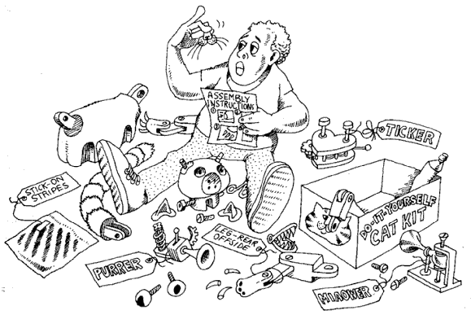
Modularity
Modularity packages abstractions into discrete units which are developed independently
From Object-Oriented Analysis and Design with Applications
Notes:
Modularity is the property of a system that has been decomposed into a set of cohesive and loosely coupled modules
Modularity is essential for managing complexity, especially in huge applications. An application can be developed in small modules, which can be compiled separately, but have connections with other modules.
Modularity is supported in diverse ways in different languages. In C++, a class declaration is placed in a header file & the definition in an implementation file(.cpp). Namespaces can be used to logically group related classes in one logical structure. Classes can also be placed in static or dynamic library. Dependency between the modules is then asserted with either #include preprocessor directive or the using directive. In Java, a program can be divided in package or assemblies in C#.
Classes for a small application can be put in the same library or namespace. But for big applications, it makes sense to have a logical division of related classes. Logical division can be through namespaces. Libraries can physically divide the classes into separate compilation units.
Sometimes, modularization is taken to extremes. Too much modularization is bad. Consider a windows GUI application. This application responds to several hundered messages. It would be unwise to create separate classes in separate modules for every message. This would be a poor design decision and would create maintenance nightmare.
Modularity results in reduction of the overall cost of the software, by allowing modules to be independently designed. However, the module should have a narrow interface so that it is possible to change the module without effecting other dependent modules.

Slide 64
Discussion
Manages complexity of writing large applications
Many teams can work on one application
Modules can be independently designed
Loosely coupled
Ease of reuse

Slide 65
Command Pattern
Encapsulate a request as an object, thereby letting you parameterize clients with different requests, queue or log requests, and support undoable operations
Enables a class to make requests to unknown or unspecified objects.
Such objects have a state and know how to undo their operations
Command pattern decouples the object that invokes the operation from the one having the knowledge to perform it
It is also known as Action/Transaction

Slide 66
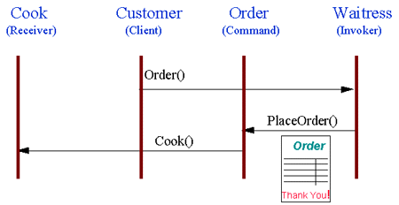
Non-software Example
The "check" at a diner is an example of a Command pattern. The waiter or waitress takes an order, or command from a customer, and encapsulates that order by writing it on the check. The order is then queued for a short order cook. Note that the pad of "checks" used by different diners is not dependent on the menu, and therefore they can support commands to cook many different items.

Slide 67
Structure
Client
Invoker
Command
Execute()
Receiver
receiver
ConcreteCommand
Action()
Execute()
receiver->Action();
state

Slide 68
Implementation
A command can either itself perform all operations or just forward the call to receiver
Commands can support undo and redo and have state to supplement these operations. The state can be
the Receiver object, which actually carries out operations in response to the request,
the arguments to the operation performed on the receiver or
any original values in the receiver that can change as a result of handling the request. The receiver must provide operations that let the command return the receiver to its prior state

Slide 69
Implementation
For undo and redo, copies of existing commands have to be stored in history
Macro commands can be created
several command objects are stored in a list and executed sequentially
Not all operations are undoable

Slide 70
C++ Implementation
Can be implemented through
function pointers
function objects
command objects

Slide 71
C# Implementation
Delegates & events can be used to implement callbacks
In this case, the command object is invoked through an event
Simple to implement

Slide 72
Consquences
The invoker and the handler are loosely coupled through the command object
reduces dependency
Can be manipulated and extended like any other object
create variations of commands
Command objects can be assembled
macros
It's easy to add new Commands, because you don't have to change existing classes

Slide 73
Applicability
Commands are object oriented replacement for callbacks
Use for queuing requests to be executed at different times
Create macro commands
Use for implementing undo and redo
command object can store undo & redo state
Can be used for transactions
In case of a failure, the system can be reverted to original state

Slide 74
Known Uses
Command is extensively used in UI programming while handling callbacks from controls
MFC uses message maps to handle the commands
C# uses events & delegates as commands
provides EventHandler delegate for handling events
Java uses ActionListener as a command object
Boost & QT use signals & slots for commands

Slide 75
Strategy Pattern
Define a family of algorithms, encapsulate each one, and make them interchangeable. Strategy lets the algorithm vary independently from clients that use it.
Replacement for conditional statements
Algorithms that have the same behavior are encapsulated inside separate classes
These classes are parented by a common class
common parent ensures the algorithm can be changed at runtime
Also known as a policy
Notes:
Different compression libraries are available. Some give best results when compressing binary data while other work better when compressing documents with images. The following libraries are available
Unrarlib – gives support for RAR archives created through WinRAR
DjVuLibre Document and Image Compression Library – specifically designed for compressing documents with images
libmspak – gives support for archives created through Microsoft’s compress.exe utility. Works with cabinet files, compiled HTML, etc

Slide 76
Structure
Strategy
Context
AlgorithmInterface()
ContextInterface()
ConcreteStrategyA
ConcreteStrategyB
ConcreteStrategyC
AlgorithmInterface()
AlgorithmInterface()
AlgorithmInterface()

Slide 77
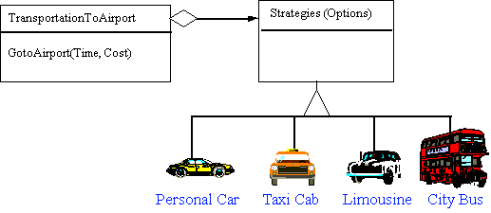
Non-software Example
Modes of transportation to an airport is an example of a Strategy. Several options exist, such as driving one's own car, taking a taxi, an airport shuttle, a city bus, or a limousine service. For some airports, subways and helicopters are also available as a mode of transportation to the airport. Any of these modes of transportation will get a traveler to the airport, and they can be used interchangeably. The traveler must chose the Strategy based on tradeoffs between cost, convenience, and time

Slide 78
Implementation
Strategies might require data to operate on from the Context
Context can push the data to the strategy
Strategy may pull the data from Context
A strategy may not always be available
Context class can implement a default behavior
requires a null check
alternatively use Null Object pattern

Slide 79
Null Object Pattern
Alternative to null check
A strategy is used automatically when the clients don’t specify a custom strategy
Has a do-nothing behavior
Simplifies the code & makes it readable
Will often be singleton as it does not have a state

Slide 80
C++ Implementation
Templates & function objects can be used to configure a Context with a Strategy.
Only if
the strategy can be selected at compile time
it does not have to be changed at run time
Advantage of using templates is that you can use any callable type as a strategy

Slide 81
C++ Implementation
Lambda expressions & function pointers can be used as one-shot strategies
No need to have a hierarchy of classes
But no OO advantage with function pointers
Use std::function<> to wrap any callable for flexibility without relying on templates explicitly

Slide 82
Performance
Using templates for strategies is preferable in C++
Templates are instantiated at compile time
Compiler can apply optimizations e.g. a function object can be inlined when instantiated as a template
The C++ standard library uses templates as strategies in most algorithms

Slide 83
Java Implementation
You can use an anonymous class wherever a strategy is required
If the strategy interface is a functional interface, then a lambda expression can be used instead of a class
better than anonymous classes if fields or initialization is not required

Slide 84
C# Implementation
C# supports delegates that are similar to function objects in C++
No need to create a hierarchy of classes
More aligned with C# syntax and is still object oriented
supports all OO features
Anonymous delegates can be used as well
Alternatively, use lambda expressions

Slide 85
Consequence
Alternative to inheritance
instead of adding new behavior to Context class through inheritance, use Strategy
Alternative to conditional statements
Code containing many conditional statements often indicates the need to apply the Strategy pattern
existing code need not be modified

Slide 86
Consequence
Strategies provide different implementations of the same behavior.
A client can choose among strategies with different time and space trade-offs
The number of classes increase in the application
The client must understand how the strategies differ and which one to choose,
may have to understand the implementation of each
The class code becomes distributed that makes it harder to understand the system

Slide 87
Applicability
Use the Strategy pattern when
classes differ only in their behaviour and you want to configure an application with one of many behaviours
you need different variants of an algorithm
many behaviours of a class are represented through
conditional statements
inherited classes
a class is tightly coupled with different classes that provide same behaviour with different implementations

Slide 88
Known Uses
The CListCtrl in MFC uses a a callback function to sort elements
ACE Library & ATL use Strategy with Null Object Pattern for choosing synchronization primitives through templates
STL provides algorithms that can be customized through function objects or function pointers
In C#, a client can implement custom sorting for any class through IComparer interface. IComparer is a Strategy interface
Java provides a similar interface called Comparable for providing alternative comparisons between objects
In Java, CheckInputStream and CheckOutputStream classes can compute checksums through strategy classes Adler32 and CRC32 that are represented by CheckSum base class

Slide 89
Problem
In an application, how to modularize user interface functionality, data persistence, etc, so that the individual parts can be modified separately?
For example, in a web application, the UI changes frequently than the business logic
Pages may be shuffled around or new pages may be added

Slide 90
Forces
The same data may be presented in different forms
Designing UI requires a different skillset than designing business logic and rarely one person has both skillsets
UI code tends to be device dependent than business logic

Slide 91
Model View Controller
Invented by Smalltalk programmers
Used by applications that present data to the user
Uses the principle of “separation of concerns”
Basically, the responsibility is divided into different components instead of being defined into one

Slide 92
Model View Controller
An application that presents data to the user has to handle the following tasks:
Take data from the user
Present data to the user
Save the data into a data store (e.g. database)
Implementing all functionality in one component will make the code complex and difficult to maintain
MVC suggests a design that breaks down the responsibilities into different components

Slide 93
MVC
MVC proposes three main components
Model : manages the behavior and data of the application and
responds to requests for information (usually from the view)
responds to instructions for change in state(usually from the controller)
View : manages the display of information
Controller : accepts input from the user and informs the model or view to change

Slide 94
MVC
Manager
Controller
Model
View
Data
Presentation

Slide 95
MVC Models
MVC has two variations
Passive Model : Here the controller manipulates the model exclusively and then informs the view about the change. The model is completely independent of the view
Active Model : This model is used when the model changes the state without controller’s involvement. The model may change from some other source and has to inform the view of the change

Slide 96
Consequences
Multiple representation of the same data without any dependencies from model to view
UI changes do not percolate to other components and are independent
New UI can be added for different devices
Maintenance is easier

Slide 97
Consequences
Introduces new levels of indirection
Complexity increases
Code becomes harder to debug due to increased nature of event-driven nature of UI
Frequent updates if the model is changing often. May lead to flood of unnecessary updates on the views

Slide 98
MVC Using Observer Pattern
Controller
<<interface>>
Observer
Model
View

Slide 99
Known Uses
MVC is implemented in most of the frameworks that have to display data to the user
MFC uses a variation called Document-View architecture
Microsoft provides a framework called MVC for creating web applications and also has variations calls MVVM and MVP
Apple’s iOS SDK uses MVC for it’s GUI applications
Android also uses MVC for GUI applications

Slide 100
Observer Pattern
Define a one-to-many dependency between objects so that when one object changes state, all its dependents are notified and update automatically
Describes how to establish a one-to-many relationship
Key objects are subject and observer
one subject & many observers
all the observers are notified whenever the subject undergoes a change in state
Subject sends notifications without having to know who its observers are.
any number of observers can subscribe to receive notifications
Also known as publish-subscribe

Slide 101
Structure
observers
Observer
Subject
Update()
Attach(Observer)
Detach(Observer)
Notify()
for all o in observers{
o->Update()
}
ConcreteSubject
subject
ConcreteObserver
GetState()
SetState()
Update()
observerState=
subject->GetState()
return subjectState
observerState
subjectState

Slide 102
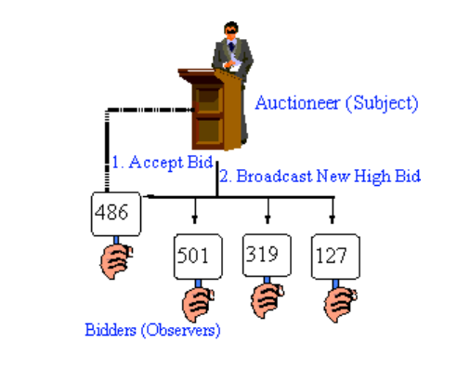
Non-Software Example
Some auctions demonstrate this pattern. Each bidder possesses a numbered paddle that is used to indicate a bid.
The auctioneer starts the bidding, and "observes" when a paddle is raised to accept the bid.
The acceptance of the bid changes the bid price, which is broadcast to all of the bidders in the form of a new bid.

Slide 103
Implementation
The subjects keep track of their observers by keeping a reference of each
Array, List
An observer can depend on more than one subject.
Have the subject tell the observer who it is via updating interface
Update is triggered by the subject itself on a state-setting operation, observer or by the clients

Slide 104
Implementation
Observers can register for specific events only
more efficient as it avoid unnecessary updates
only those observers will be updated that are dependent on the data that has changed
Before the subject notifies its Observers, it should be in a consistent state
Use template method to avoid inconsistency

Slide 105
Push Model
The subject sends observers detailed information about the change
not efficient (for large data)
not all observers may require the data
difficult to generalize data for different types of observers
Better use a general type (Object, void *) as a hint for the type of data changed

Slide 106
Pull Model
Minimal information is sent to the observer
Observer asks for details explicitly thereafter
Can be used with all types of observers
It may be difficult for the observers to ascertain what data has changed

Slide 107
Language Specific Implementation
In C#, delegates & events can be used for notifying the observers
more aligned towards C# language
Java provides Observer interface & Observable class
provides the framework for registration, deregistration & notification
C++ - function pointers & function objects

Slide 108
Consequences
Minimal coupling between Subject and Observer
subjects can be reused without reusing their observers & vice versa
observers can be added without modifying the subject
subjects only need to know the update interface
subject & observer can belong to different layers
Notes:
Subject has no idea of how many observers exist or what the observer does with the notification. This gives a complete freedom of adding and removing observers dynamically

Slide 109
Consequences
Support for broadcast communication
No need to specify the receiver of the notification. The notification is broadcast automatically to registered observers
subject is not dependent on observers, their number or what they do with the notification

Slide 110
Consequences
Observers don’t have any knowledge of each others presence.
Must be careful about triggering updates
Simple update interface makes it difficult for the observers to deduce changed item
Too many changes in the subject may cause a flood of updates in the observers

Slide 111
Applicability
The Observer pattern can be used when
a change to one object requires changing others, and you don’t know how many objects need to be changed
an object should be able to notify other objects without depending on those objects
several objects should synchronize their state with other objects

Slide 112
Known Uses
Often used with Model View Controller
Java provides Observable class & Observer interface as built-in support for observer pattern
In .NET, delegates and events can be used to trigger notifications
MFC uses Observer pattern in its Document View Architecture
QT & Boost use signals & slots
In COM, connection points architecture is based on Observer pattern
Used extensively in web applications as a part of Model View Controller
Most of the applications with multiple views rely on Observer pattern to keep the views in sync with the data

